Slide 1
Terrorism Risk Insurance Act
Presentation by Dennis Fasking, FCAS, MAAA
Midwestern Actuarial Forum
September 23, 2004

Slide 2
Terrorism Risk Insurance Act
Enacted November 26, 2002 in response to 9/11 terrorism attack
Temporary federal Terrorism Insurance Program administered by the US Treasury Dept.
System of shared public and private compensation for insured losses resulting from acts of terrorism
Intended to provide for availability of affordable P&C insurance until private markets stabilize and build capacity
Commercial insurers must offer coverage for terrorism; insured doesn’t have to buy
Voided all existing terrorism exclusions
Must disclose the premium charged for terrorism and the government’s participation
Federal government provides reinsurance backstop for insurers (90% of losses over the insurer’s retention) for “certified” acts of terrorism, up to Industry Cap of $100 Billion

Slide 3
Certified Act of Terrorism
Terrorism action by an individual or individuals acting on behalf of any foreign person or interest
Property and casualty insurance losses exceed $5,000,000 in aggregate
Violent act or an act that is dangerous to human life, property or infrastructure
Certified by the Secretary of the Treasury, along with the Secretary of State and the Attorney General of the US

Slide 4
Lines of Insurance
Commercial Lines except
  Crop insurance
  Mortgage guarantee
  Financial guaranty
  Medical malpractice
  National flood insurance program
  Life and health insurance

Slide 5
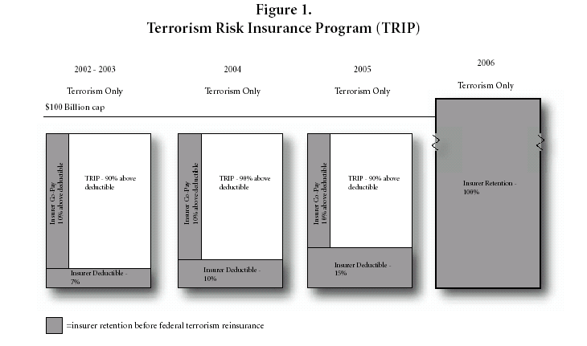
Increasing Retention by Insurers
Annual Industry Aggregate Cap = $100 billion in Losses

Slide 6
Terrorism Modeling
Presentation by Dennis Fasking, FCAS, MAAA
Midwestern Actuarial Forum
September 23, 2004

Slide 7
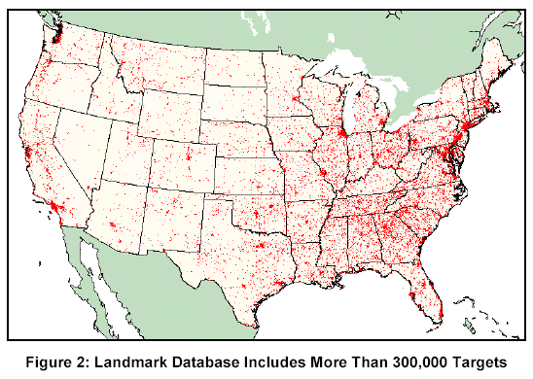
Where are Terrorist Attacks Most Likely?
No surprise that highest concentration would be major cities with financial and political importance.

Slide 8
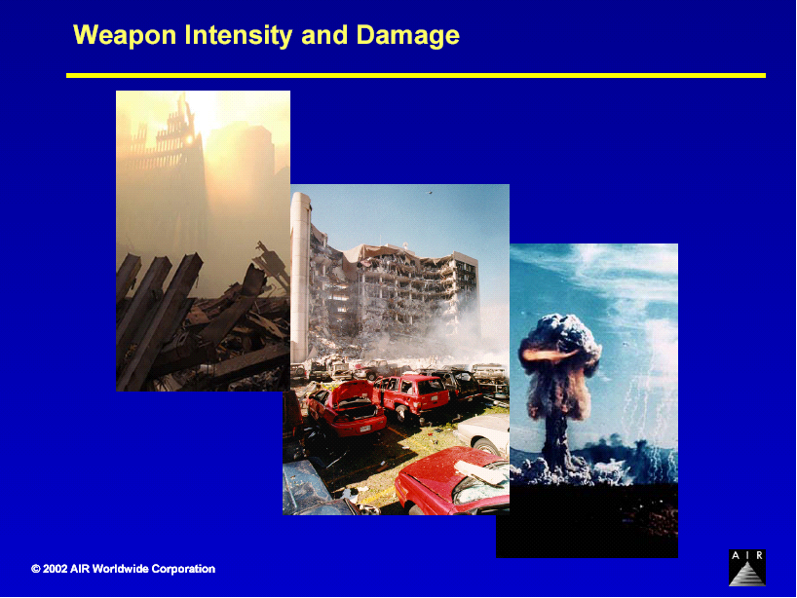

Slide 9
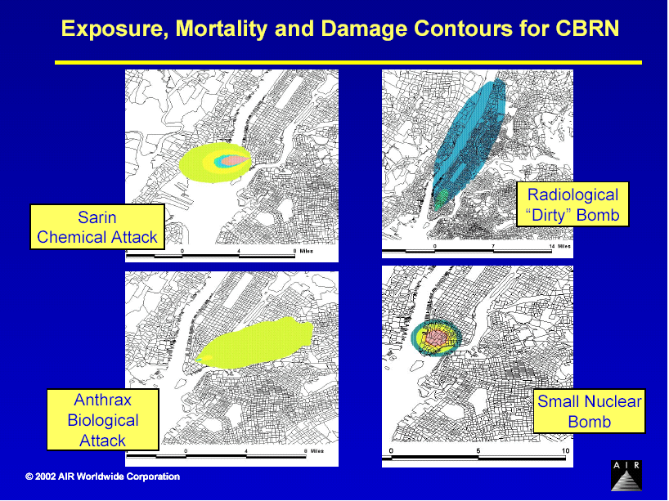
Besides Blasts and Plane Crashes, What Else do Terrorists Want to Use?

Slide 10
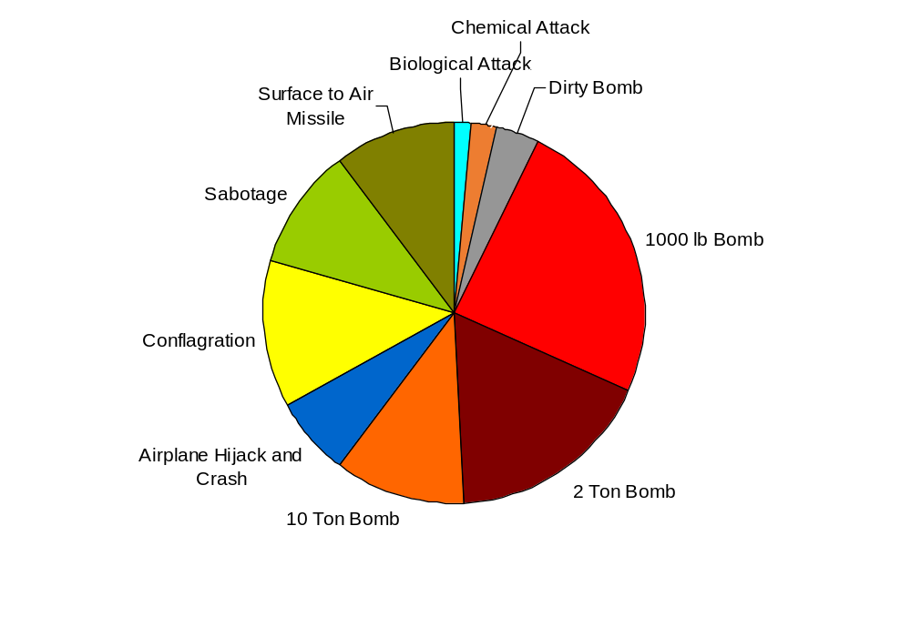
Attack Modes
Probability of Attack Mode
(given an attack)
Improvised explosive device
  1000 lb yield Truck bomb
  2 ton yield Vehicle Bomb
  10 ton yield Container Bomb
Purchased military equipment
  SAM missile attack on passenger jet
Using civilian items as weapons
  Aircraft hijacked and flown into a target
  Arson attack with hijacked gasoline tanker
Armed attack
  Sabotage of a major facility by an armed group
Radiological dispersal attack
  ‘Dirty bomb‘, 0.5 kg low-level waste
  ‘Dirty bomb’, 10 kg spent fuel rod
Chemical nerve gas attack
  4mg Chemical Attack (Sarin nerve gas)
  Major Chemical Attack (Sarin nerve gas)
Biological agent attack
  Virulent Biological Attack 100mg (Anthrax)
  Virulent Biological Attack 1 kg (Anthrax)
  Virulent Biological Attack 10 kg (Anthrax)
Nuclear detonation attack
  1-kiloton nuclear weapon
  5-kiloton nuclear weapon
Attack type | Likelihood
Bomb (2 ton) | 17.40%
Bomb (10 ton) | 11.00%
Bomb (1,000 lb) | 24.50%
Surface to air missile | 10.30%
Airplane hijack and crash | 6.80%
Conflagration | 12.30%
Sabotage | 10.30%
Chemical attack | 2.30%
Biological attack | 1.29%
Dirty bomb | 3.50%
Nuclear bomb | 0.26%
Fasking, Dennis (2004, September 23). Terrorism Risk Insurance Act. AIR Worldwide. Presentation, Midwestern Actuarial Forum: at https://www.casact.org/community/affiliates/maf/0904/Fasking.ppt (retrieved 21 September 2015).

Slide 11
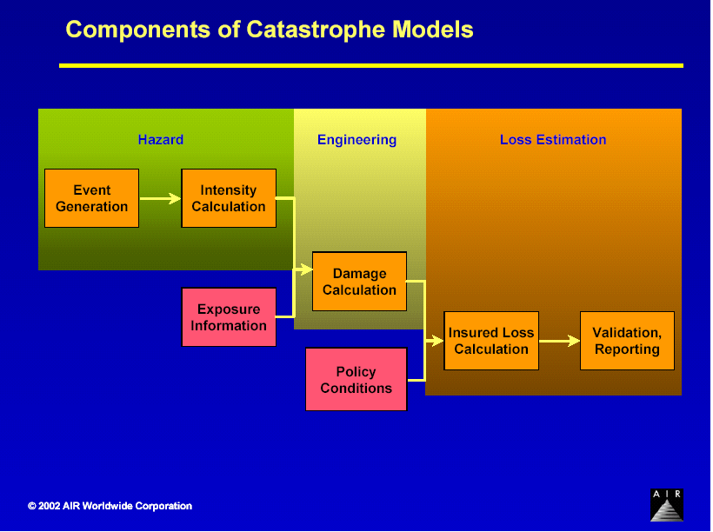
Components of All Catastrophe Models
The 3 Main Things to Think About for Terrorism Modeling are:
Target, Weapon, and Location

Slide 12
Terrorism Attack Modeling Framework
Choose a Weapon Mode, Size & Effectiveness
Select the Number of Synchronized Attacks
Select Target Location
Pick a Target for Each Individual Attack
Identify the Level of Intelligence and Target Security/Hardening
Evaluate the Loss Consequences

Slide 13
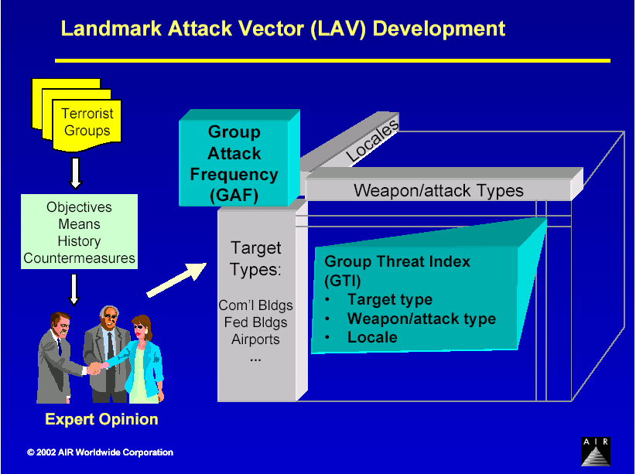
Putting All the Model Pieces Together

Slide 14
Potential Uses for Modeled Terrorism Losses
Risk Management Strategy
Model Capability
Risk Identification
  Identifying threats (solvency, profitability)
  PML management
Risk Management Actions
  Rating Agencies and other public disclosures
  Risk-based capital allocation
  Product engineering (coverage exclusion or reduction)
  Pricing (of remaining coverage)
  Risk transfer
  Underwriting guides
Measurement
  Deterministic runs of large loss scenarios; full loss curves
  PML measurement; identification of any concerns and solutions
Supporting Activities
  Measurement of terrorism’s likely PML contribution
  PML, as input into capital allocation formulae
  Measurement of loss exclusion or reduction
  EAL measurement (post loss reduction)
  Layers of loss analyses for reinsurance or other risk transfer price and terms for negotiations process
  Knowledge of threat (targets, damage footprints, accumulation of risk, likelihood of threat, etc.)
Notes:
Final slide discusses some of the perceived model capabilities, IF the model(s) can pass our TBD due-diligence examinations:
Identification of the risk itself and impact on our solvency, profitability, PML management, and other prudent measures
Aiding identification and discussion of potential risk management actions regarding terrorism loss exposure
Measurement of both deterministic and probabilistic runs of terrorism loss scenarios, comparable to those we run for hurricanes and earthquakes
In support of other measurements and strategic management actions dealing with the larger, more uncertain losses of the corporation
We are expecting to get approval of the $200,000 needed to contract for AIR’s model for 2003 and to begin to develop and implement a due-diligence validation and sensitivity testing procedure that we feel are necessary before its output can become part of management’s response to this post-9/11 threat.
In the meantime, it is our understanding that prudent steps are being taken to limit our unintended exposure to terrorism losses through more restrictive policy language.

Slide 15
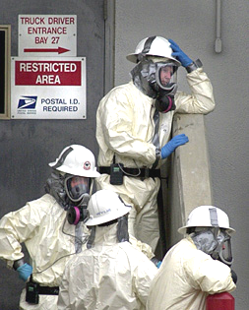
Decontamination @ X times Cost of Structure
No ‘acceptable’ level of contamination of biological agents
‘Acceptable’ radiation levels pre-determined by NRC will need to be pragmatically revisited
No established methodologies for biological and radiation decontamination of city building stock
Decontamination will drive costs of radiation and biological attacks
  Determines when offices can be re-occupied and hence BI costs
  Near point of release, once costs of decontamination exceed building values, building and land values will be negative

Slide 16
Sources of Uncertainty in Terrorism Loss Modeling
Primary
  Probability of an attack (and of attack success)
  Conditional probabilities of weapon type and target
Secondary
  Impacts at a location
  Vulnerability
Independent compounding factors
  Time of day (for locations of workers)
  Potential for evacuation (for mortality of workers)
  Climatic: wind speed and direction
Contractual
  ‘Event’ definitions
  Operation of exclusions
  Definition of coverage & contingencies
Political:
  Absence of definitions around safe levels of CBR contaminants
  Political pressures on insurers to make available, affordable coverage
  Government has what little control there is
Most
Significant

